Slide 1
Report to HACA Board of Commissioners: Organizational Changes and Training Impact
By Monique Pierre, CEO
(Through)
Elaine V. Scott
Internal Audit and Compliance Specialist
March 27, 2024

Slide 2
Introduction
Purpose of Training Sessions:
The purpose of the training sessions conducted at the Asheville Housing Authority was to equip our HCVP team members with essential skills and knowledge to enhance operational efficiency, foster strategic decision-making, and drive positive change within our organization.

Slide 3
Process Development Training Sessions – Agenda
PROCESS PLANNING MEETING 3
Understanding KPI
February 15, 2024, 12:00 p.m. – 2:00 p.m.
AGENDA
Introduction to KPIs (5 mins) (All)
Explain purpose and objective.
Go over ground rules.
Pep Talk. (Elaine Scott)
Types of KPIs (10 mins) (Elaine Scott)
Pick one process and do it as a group.
Understanding types of KPIs.
Discuss scope for today (Presentation and Slides).
Go over scenarios related to housing authorities to perform KPI collectively.
Identifying Relevant KPIs (60mins) (All)
Identify and select KPIs that may carry some relevance Asheville Housing Authority’s goals.
Understand why KPIs are important.
Start KPI
Implementing KPIs (15 mins) (All)
Strategies for successful KPIs.
Group discussion: Share experiences and challenges in implementing KPIs.
Review and Feedback
Recap key concepts.
Questions and discussions.
Next Steps
30 / 60 / 90 day Reviews
Adjournment
PROCESS PLANNING MEETING 2
What is a SWOT Analysis?
January 25, 2024, 8:00 a.m. – 10:00 a.m.
AGENDA
Introduction (5 mins) (Monique Pierre)
Explain purpose and objective.
Go over ground rules.
Process Overview (10 mins) (Elaine Scott)
Discuss scope for today (Presentation and Slides)
Provide directions for break-out groups
Go over scenarios related to housing authorities to perform SWOT analysis collectively.
Process Mapping Group Activity (60mins) (All)
Brainstorm the steps of your SWOT Analysis and list strengths, weaknesses, opportunities and threats.
Start SWOT Analysis
Use sticky notes, flipcharts, sharpies to chart it all out
Group Presentations (15 mins) (All)
Each group’s designated member will read out loud their SWOT analysis into actionable strategies for the Housing Authorities improvement.
Q&A Session
Answer questions and clarify to ensure understanding.
Adjournment
PROCESS PLANNING MEETING 1
Process Mapping
January 8, 2023, 8:00 a.m. – 9:30 a.m.
AGENDA
Introduction (5 mins) (Monique Pierre)
Explain purpose and objective.
Go over ground rules.
Process Overview (10 mins) (Elaine Scott)
Discuss scope for today (Presentation and Slides)
Provide directions for break-out groups
Divide up staff into groups
Process Mapping Group Activity (60mins) (All)
Brainstorm the steps of your process and make a list
Start mapping the process
Use sticky notes, flipcharts, sharpies to chart it all out
Group Presentations (15 mins) (All)
Each group’s designated member will read out loud the steps of their process as mapped
Adjournment

Slide 4
Process Development Training Sessions
Session 1: Process Map
Engagement: The groups showed enthusiasm and curiosity during the process mapping exercises, actively participating in discussions and brainstorming sessions.
Understanding: Initially, there was some apprehension and uncertainty about the process mapping methodology. However, as the session progressed, participants demonstrated a growing understanding of the concepts and their relevance to their work.
Readiness to Apply: While there were initial challenges in translating process mapping concepts into actionable insights, groups showed eagerness to apply their learnings to identify opportunities for process improvement within their departments.

Slide 5
Process Development Training Sessions
Session 2: SWOT Analysis
Engagement: The SWOT analysis sessions sparked lively discussions and debate among group members, indicating a high level of engagement and investment in the process.
Understanding: Participants showed a strong grasp of SWOT analysis principles and techniques, quickly identifying internal strengths and weaknesses, as well as external opportunities and threats.
Readiness to Apply: There was a palpable sense of excitement as groups uncovered insights and strategic implications from their SWOT analyses. Participants expressed eagerness to translate these findings into actionable strategies and initiatives within their respective departments.

Slide 6
Process Development Training Sessions
Session 3: KPI (Key Performance Indicator)
Engagement: KPI training sessions initially presented a challenge for some groups, as the concept of performance metrics was new and unfamiliar to many.
Understanding: Despite the initial difficulty, participants demonstrated resilience and determination to grasp the intricacies of KPIs. As the session progressed, there was a noticeable improvement in comprehension and confidence.
Readiness to Apply: While there is still some work to be done in fully integrating KPIs into daily practices, participants expressed a commitment to leveraging KPI data to drive performance improvement and contribute to organizational effectiveness.

Slide 7
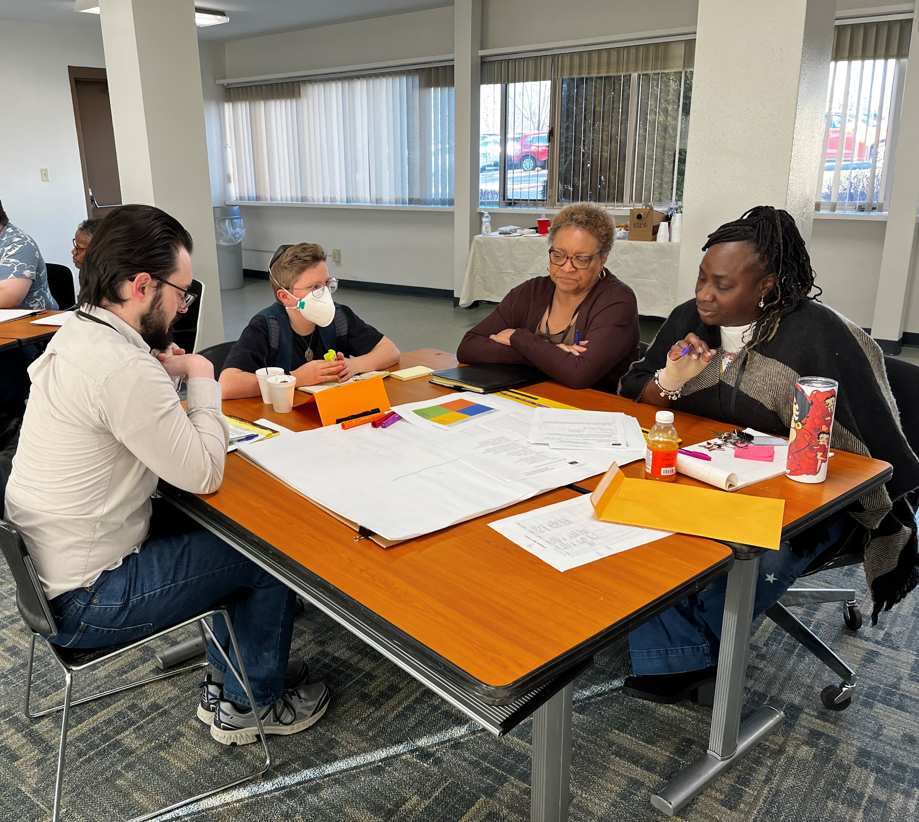
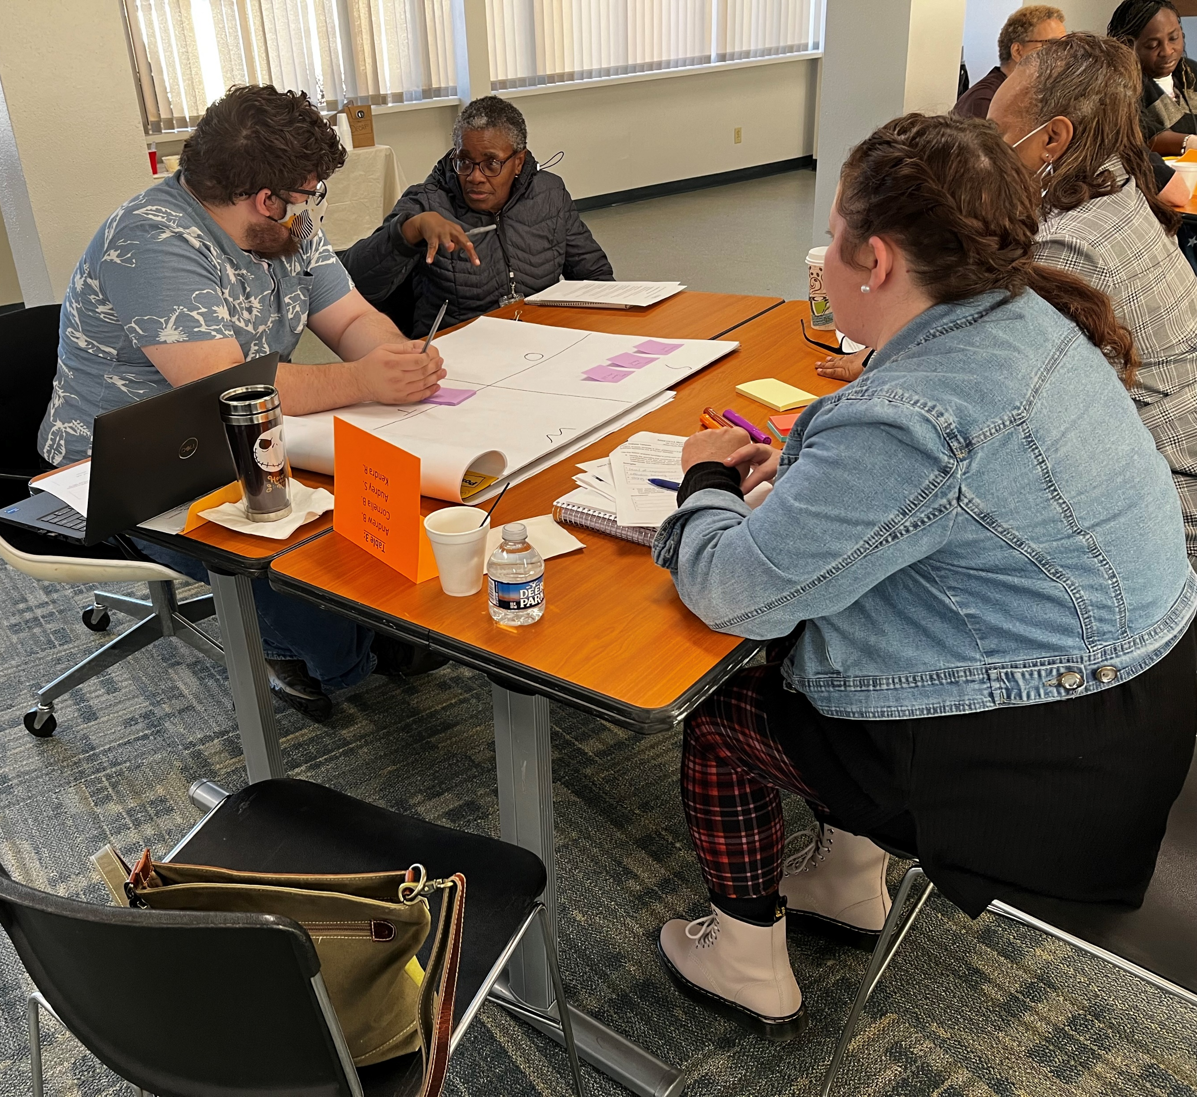
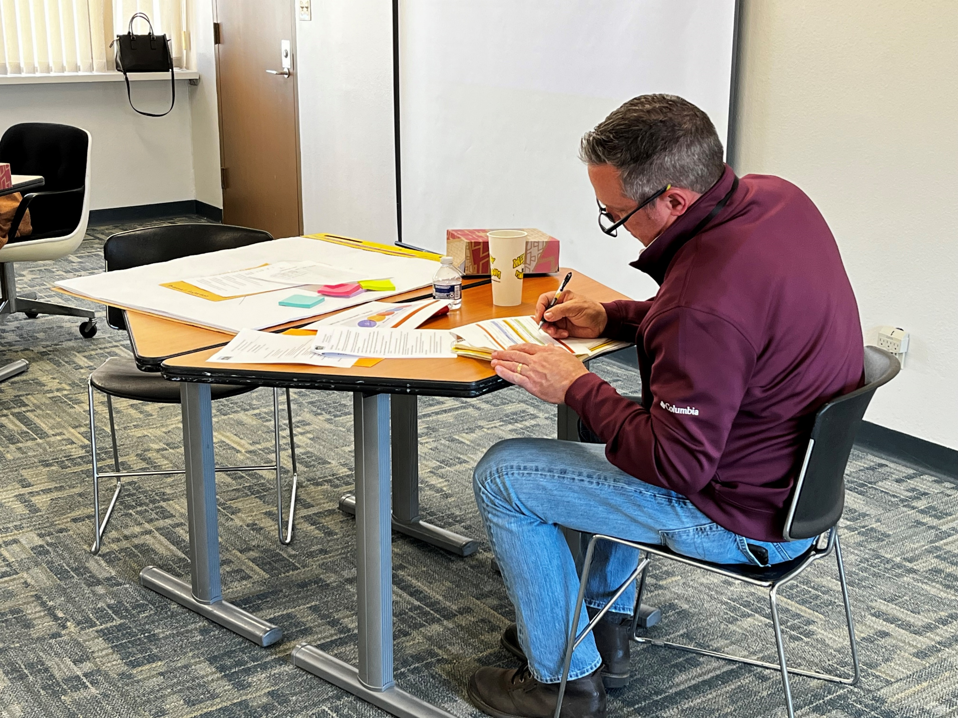
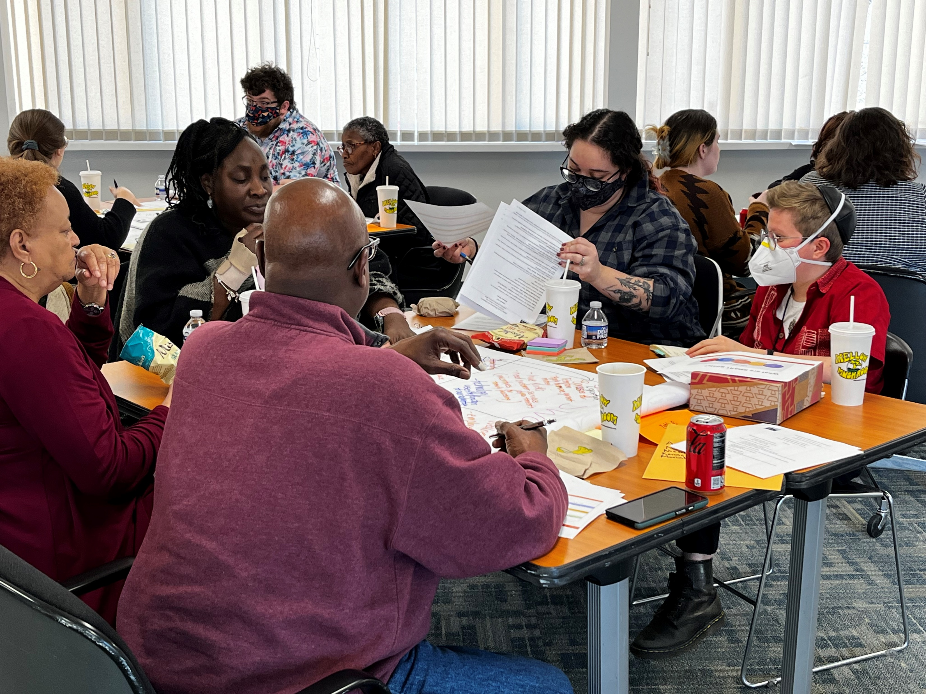
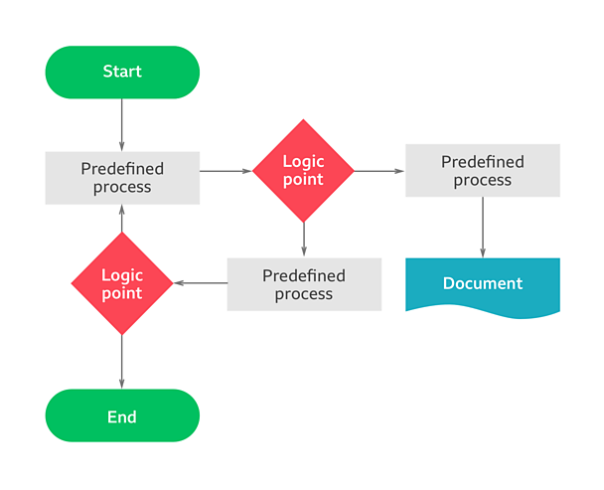
Asheville Housing Authority
2024

Slide 8
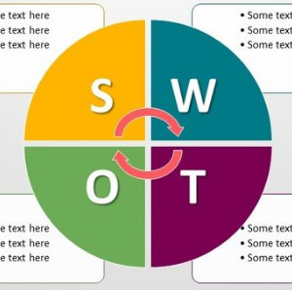
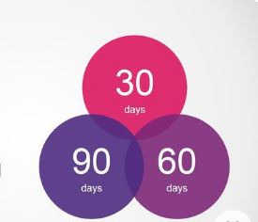
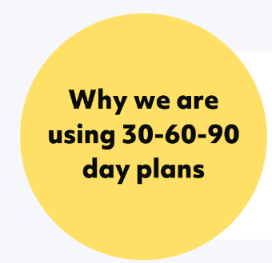
Training Session Timeline
Process Map Class
30-60-90 Day Project Completion
KPI Class
Jan. 8, 2024
8:00a – 9:30 am
Jan. 25, 2024
8:00a – 10:00 am
Feb. 15, 2024
12:00ap – 2:00 pm
May 6, 2024
Q2 2025
SWOT Analysis Class
30-60-90 Day Follow Up Begins

Slide 9
Conclusion
The objective of this and future organizational assessments is to involve our staff in the process to examine and improve the work processes that they are involved in.
This reflects our strategic focus on building a skilled, engaged, and resilient workforce that is capable of driving organizational excellence and delivering positive outcomes for our community. Through continuous investment in training and professional development, we are positioning ourselves for long-term success and sustainability as a leading provider of housing solutions in Asheville.

